Slide 1
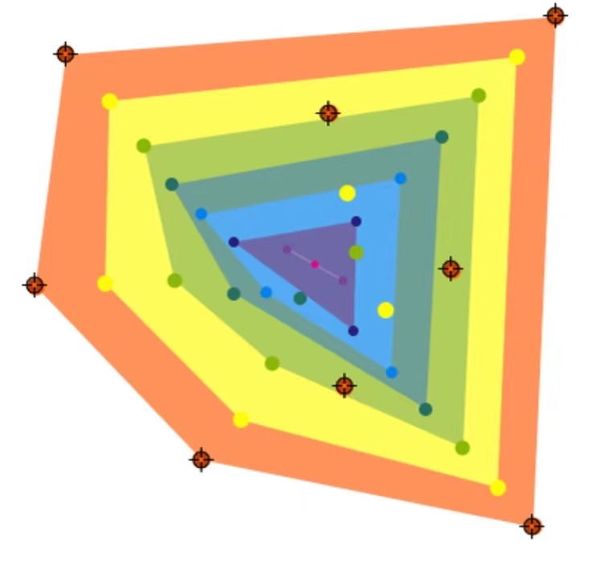
Gauss-Lucas Theorem
By Yizhong, Jiayuan
[1]

Slide 2
“Zeros of P’(z) never escape”

Slide 3
Theorem Statement

Slide 4
If P(z) is a non-constant polynomial with complex coefficients,
all zeros of P’(z) belong to the convex hull of the set of zeros of P.[2]

Slide 5
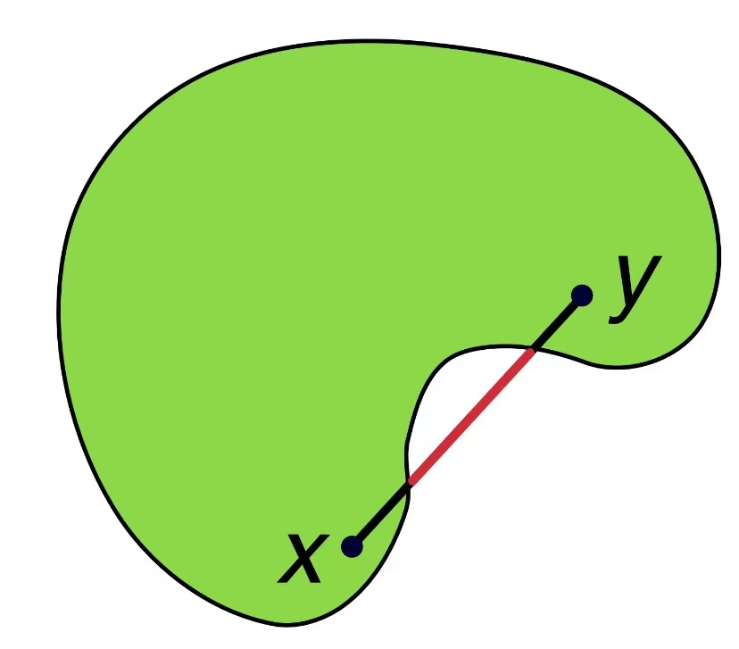
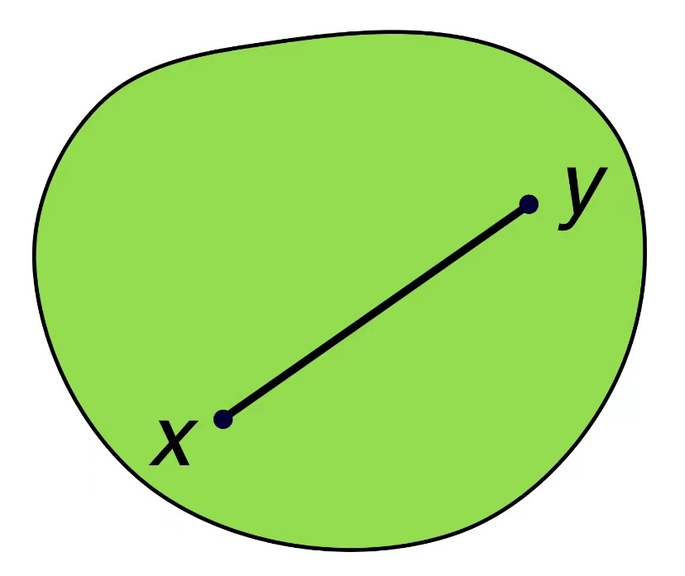
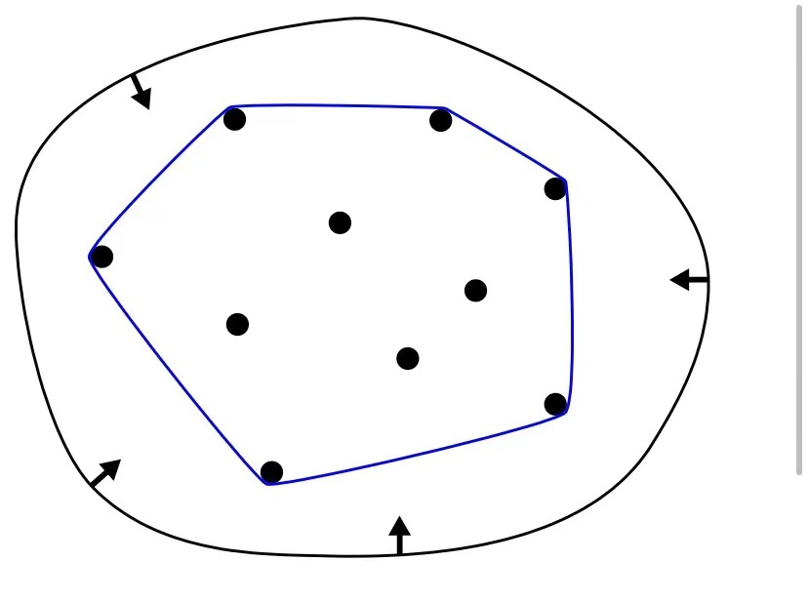
Convex and Convex Hull
A set C is convex if, for all x and y in C,
the line segment connecting x and y is included in C.
The convex hull of a given set X can be defined as
the minimum convex set containing X.
Example of non-convex set
(in green) [4]
Example of convex set
(in green) [4]
Example of convex hull
of a set with 10 points [5]
If P(z) is a non-constant polynomial with complex coefficient,
all zeros of P’(z) belong to the convex hull of the set of zeros of P.

Slide 6
Relation to Rolle’s Theorem

Slide 7
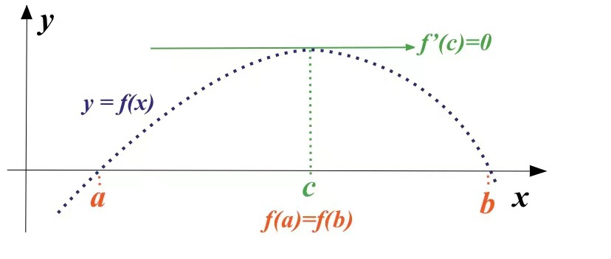
Rolle’s Theorem
If a real-valued function f is
continuous on a proper closed interval [a, b],
differentiable on the open interval (a, b),
f(a) = f(b),
then there exists at least one c is the open interval (a, b) such that f’(c) = 0.
[6]

Slide 8
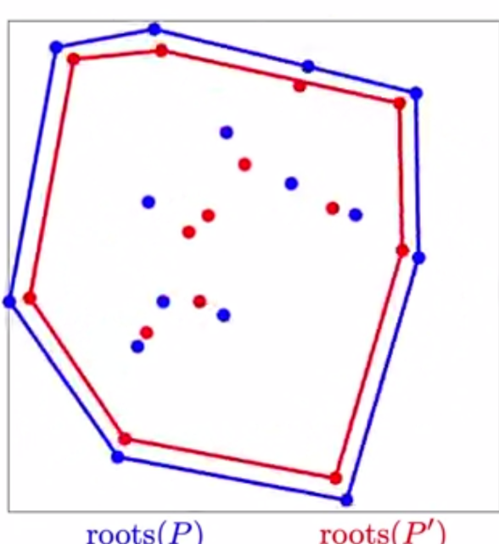
Rolle’s vs. Gauss-Lucas
Similarities:
When we take f(a) = f(b) = 0 in Rolle’s​​ Theorem,
the two theorems both describe the distribution of stationary points given the distribution of zeros.
Differences:
Real-value functions vs. Complex-value functions
Continuous and differentiable (inside) vs. polynomial
Need to know two points with same functional value vs.
Need to know all zeros
Open interval (a, b) vs. Convex hull of all zeros
Some stationary points vs. all stationary points
[2]

Slide 9
Special Cases

Slide 10
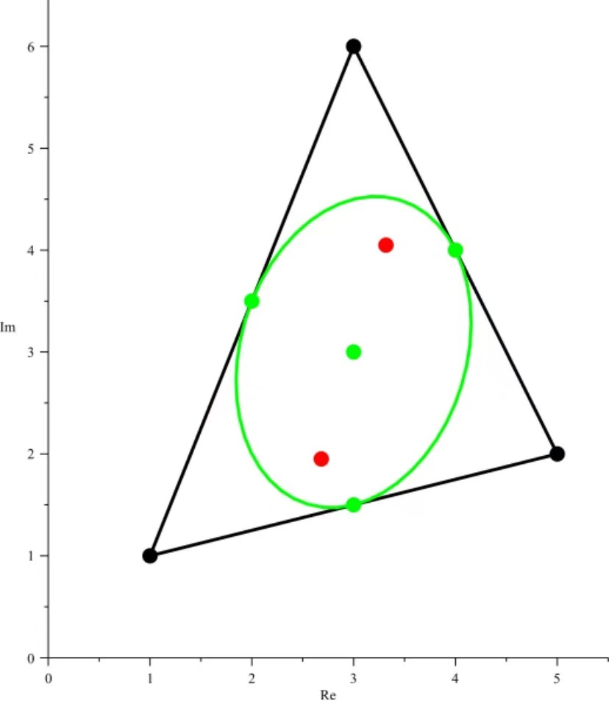
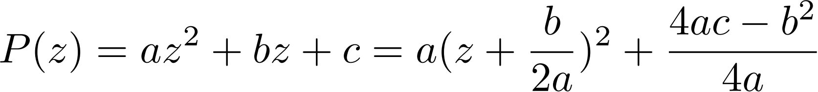
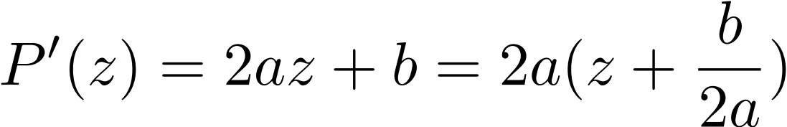
Polynomial of Degree 2
Let ,
the zero of
is the average of the roots of P.
Therefore, the average of the roots is the middle point of the segment.
Red dots are zeros of P(z).
[3]
If P(z) is a non-constant polynomial with complex coefficient,
all zeros of P’(z) belong to the convex hull of the set of zeros of P.

Slide 11
Polynomial of Degree 3
Marden’s Theorem (No proof):
Suppose the zeroes z1, z2, and z3 of a third-degree polynomial P(z) are non-collinear. There is a unique ellipse inscribed in the triangle with vertices z1, z2, z3 and tangent to the sides at their midpoints: the Steiner inellipse. The foci of that ellipse are the zeroes of the derivative P'(z).
Red dots are zeros of P’(z).
[3]
If P(z) is a non-constant polynomial with complex coefficient,
all zeros of P’(z) belong to the convex hull of the set of zeros of P.

Slide 12
More Generalized Cases

Slide 13
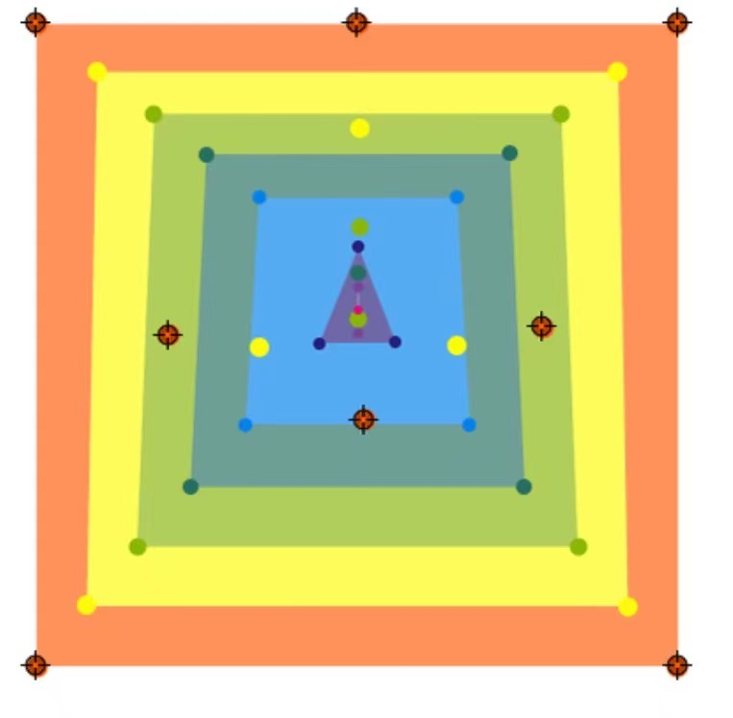
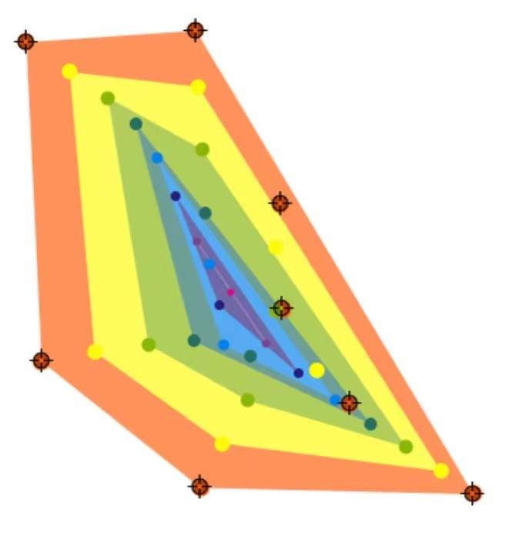
Illustration of zeros distribution
Consider three polynomials with degree 8,
and we repetitively mark the zeros of its derivative:
[1]
[1]
[1]
If P(z) is a non-constant polynomial with complex coefficient,
all zeros of P’(z) belong to the convex hull of the set of zeros of P.

Slide 14
An Important Lemma

Slide 15



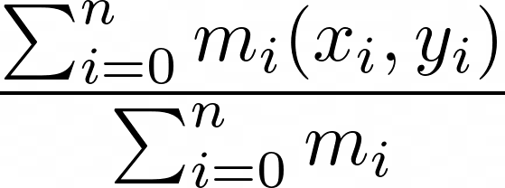
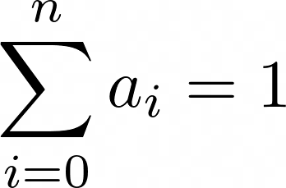

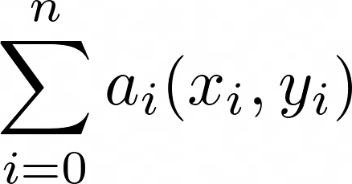
Lemma: CoM belongs to Convex Hull
Given points for , assign each point a mass of , then the center of mass
belongs to the convex hull of the points
I.e. For , the point
Belongs to the convex hull of the points

Slide 16
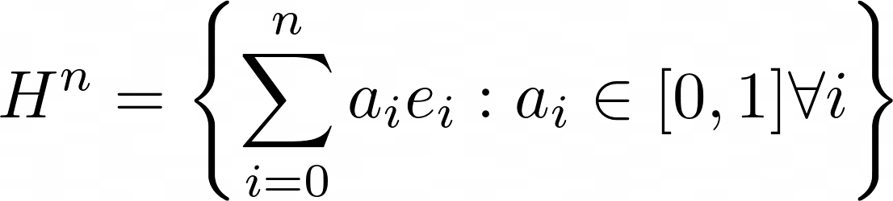
Lemma: Proof
Consider the set
where e1, .., en standard basis of Rn.

Slide 17




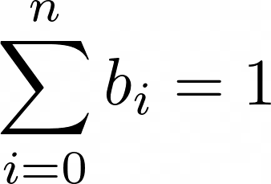

Lemma: Proof
Consider linear transformation
Let , it is the convex hull of points :
Convex: For any , straight line that connects:
We can write, for some ,

Slide 18

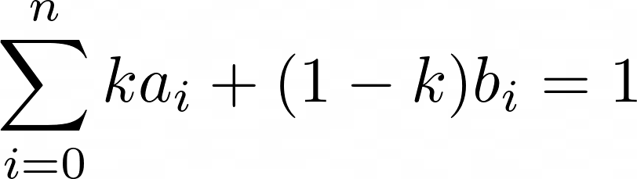




Lemma: Proof
We have, for any
Since , , , so
We have that for any , The line L connecting the two points are in , so is convex.
Consider points with weights ,

Slide 19
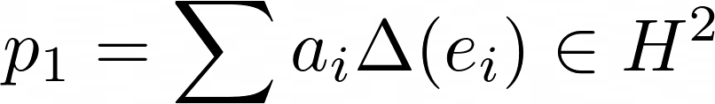
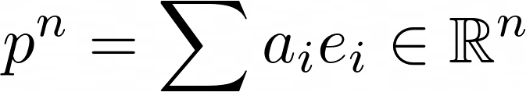

Lemma: Proof
Minimal Convex Set: Let , say that without this point, the set is still convex. We will reach a contradiction.
Consider a ray from e1 to , it intersects some segment connecting ei, ej at some p2. We prove that this segment connecting these two points is mapped into as a straight line containing p.
Since , this set is then not convex.

Slide 20
Theorem Proof

Slide 21
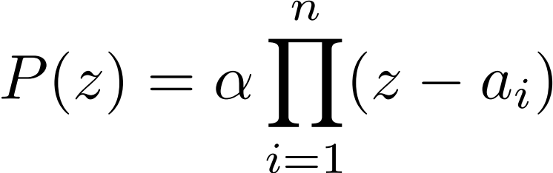
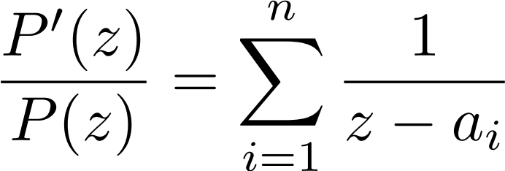
Theorem Proof
We are able to write every polynomial as:
,
where each ai represents for a zero of P.
Then we have for the logarithmic derivative:
.

Slide 22



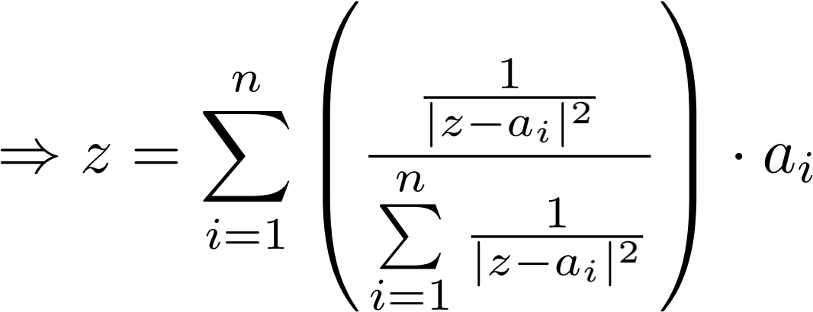
Theorem Proof
Therefore, if and ,
.
Multiply the numerator and denominator by ,
.
Therefore, z is a weighted sum with positive coefficents sum to 1. [2]

Slide 23
Citations
[1]:https://demonstrations.wolfram.com/LucasGaussTheorem/
[2]:https://en.wikipedia.org/wiki/Gauss–Lucas_theorem
[3]:https://en.wikipedia.org/wiki/Marden%27s_theorem
[4]:https://en.wikipedia.org/wiki/Convex_set
[5]:https://en.wikipedia.org/wiki/Convex_hull
[6]:https://en.wikipedia.org/wiki/Rolle%27s_theorem

Slide 24
Thank
You!

